Slide 1
Assignment 5
N-body Simulation
Parallel Programming
HW5 Specification

Slide 2
AMD Tutorial
AMD HPC User Guide

Slide 3
SSH
Username list: [Link]
ssh <username>@172.16.162.206
Required CSIE VPN: [Link]
Default Password: csie_pp25
Change Your Password after first login

Slide 4
HIP Code
Add #include "hip/hip_runtime.h" to your .cpp file
Replace all cudaXXXX with hipXXXX
  cudaMalloc -> hipMalloc
  cudaMemcpy -> hipMemcpy
  cudaMemcpyHostToDevice -> hipMemcpyHostToDevice
Compile: hipcc hw5.cpp -o hw5

Slide 5
Problem Introduction

Slide 6



N-body Simulation

Slide 7
N-body Simulation: Idea
N-body is used to predict the motion of celestial bodies. We break continuous time into discrete time steps. The time difference of each time step is given by Δt.
At each time step:
  Calculate the accelerations applied to each body.
  Update the velocities using the accelerations of each body.
  Update the positions using the velocities of each body.

Slide 8
Initial State: Positions & Velocities

Slide 9
Compute Forces

Slide 10
Compute Forces

Slide 11
Update Velocities

Slide 12
Update Positions

Slide 13
Update Positions

Slide 14
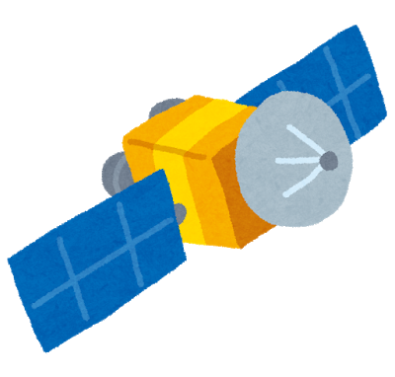
Crisis
In the future, human beings have developed a technology to create artificial gravity. Space travel is as normal as driving a car. One day, Planetary Defense Agency discovered that terrorists intend to use this technology and disguise gravity-generation devices into seemly harmless civilian spacecrafts. They want to use these gravity devices to induce multiple asteroids to hit the colonized planet with high population. If their plan works out, the planet will face massive destruction.
Your mission is to determine whether the terrorist’s plan will work and how to prevent it from attack.

Slide 15
Crisis
We will assume that the collision happens if the distance between the asteroid and the planet is less than 10⁷ m.

Slide 16
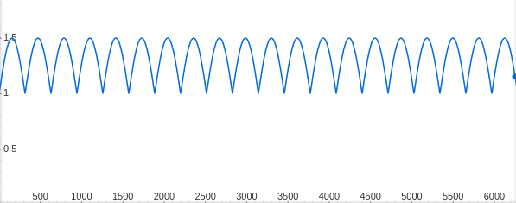
Gravity Devices
Gravity devices (type=device) have a special property: their masses will fluctuate. Refer to the spec for the detailed formula.

Slide 17

Counter-Attack
Planetary Defense Agency has to act quickly because the asteroids are so fast that it’s infeasible to deflect their direction once the asteroids get near to the planet. The best solution they can do is to destroy such gravity devices with space missiles in order to eliminate the gravitational pull.
The missile carries some explosives and fuels just enough to reach the targeted gravity device. Launching the missile has a cost positively correlated to the time that the missile will travel.

Slide 18
Counter-Attack
For the ease of simulation, we will assume:
The missile is sent from the planet
The missile can guide itself to hit the gravity device with minimal distance, i.e., it travels in a constant velocity relative to the planet.
The missile has zero mass and is unaffected by gravity
A gravity device's mass becomes zero after it is destroyed
The missile reaches the device when the travel distance is greater than the distance between the planet and the targeted device

Slide 19
The Problem
Run the simulation for a given amount of time steps (defined by the spec) and output the answers to the following questions:
If there were no gravity devices, what is the minimal distance between the planet and the asteroid?
At what time step will the asteroid hit the planet?
Can the collision be prevented if a missile is launched to destroy one of the gravity devices? If so, determine the gravity device to destroy which saves the planet and with the lowest cost.

Slide 20
Input
N planet-id asteroid-id
qx0 qy0 qz0 vx0 vy0 vz0 m0 type0
qx1 qy1 qz1 vx1 vy1 vz1 m1 type1
qx2 qy2 qz2 vx2 vy2 vz2 m2 type2
...

Slide 21
Input: Number of Celestial Bodies
N planet-id asteroid-id
qx0 qy0 qz0 vx0 vy0 vz0 m0 type0
qx1 qy1 qz1 vx1 vy1 vz1 m1 type1
qx2 qy2 qz2 vx2 vy2 vz2 m2 type2
...

Slide 22
Input: The ID of the Planet Under Concern
N planet-id asteroid-id
qx0 qy0 qz0 vx0 vy0 vz0 m0 type0
qx1 qy1 qz1 vx1 vy1 vz1 m1 type1
qx2 qy2 qz2 vx2 vy2 vz2 m2 type2
...

Slide 23
Input: The ID of the Asteroid Under Concern
N planet-id asteroid-id
qx0 qy0 qz0 vx0 vy0 vz0 m0 type0
qx1 qy1 qz1 vx1 vy1 vz1 m1 type1
qx2 qy2 qz2 vx2 vy2 vz2 m2 type2
...

Slide 24
Input: Positions of Bodies at step=0
N planet-id asteroid-id
qx0 qy0 qz0 vx0 vy0 vz0 m0 type0
qx1 qy1 qz1 vx1 vy1 vz1 m1 type1
qx2 qy2 qz2 vx2 vy2 vz2 m2 type2
...

Slide 25
Input: Velocities of Bodies at step=0
N planet-id asteroid-id
qx0 qy0 qz0 vx0 vy0 vz0 m0 type0
qx1 qy1 qz1 vx1 vy1 vz1 m1 type1
qx2 qy2 qz2 vx2 vy2 vz2 m2 type2
...

Slide 26
Input: Mass of Bodies at step=0 (fluctuates if type=device)
N planet-id asteroid-id
qx0 qy0 qz0 vx0 vy0 vz0 m0 type0
qx1 qy1 qz1 vx1 vy1 vz1 m1 type1
qx2 qy2 qz2 vx2 vy2 vz2 m2 type2
...

Slide 27
Input: Type of Body
N planet-id asteroid-id
qx0 qy0 qz0 vx0 vy0 vz0 m0 type0
qx1 qy1 qz1 vx1 vy1 vz1 m1 type1
qx2 qy2 qz2 vx2 vy2 vz2 m2 type2
...

Slide 28
Reminder
The missile is launched right from the start, meaning that at step = 1, the missile has already traveled a distance o f (1 * Δt * missile_speed).
The distance between the planet and the missile is calculated using the planet's position at the moment of launch. In other words, it can be directly calculated as (step * Δt * missile_speed).
The distance between the planet and the device needs to be calculated based on their latest positions at the current step. Assuming this distance is (dist_planet_device) , a hit is considered if (step * Δt * missile_speed) > (dist_planet_device).

Slide 29
Reminder
missle 是一開始就發射，也就是在 step=1 時 missile 已經走了 1 * Δt * missile_speed 這麼遠的距離
planet 跟 missile 的距離是用發射時當下的星球位置來算，也就是直接算 step * Δt * missile_speed 即可
星球跟裝置的距離則是要看當前兩者最新的位置來做計算，假設這個距離是 dist_planet_device，則 step * Δt * missile_speed > dist_planet_device 就算 hit。

Slide 30
Grading
Correctness (50%)
Please make sure to use GPU and verify your answer.
Performance (20%)
Based on the total time you solve all the test cases.
Report (30%)
Please describe, in detail, how you parallelize your codes and answer the questions in the spec.

Slide 31
Grading - Report
Implementation:
  What is your parallelism strategy?
  Optimization techniques?
  How do you manage the 2-GPU resources?
If there are 4 GPUs instead of 2, what would you do to maximize the performance?
If there are 5 gravity devices, is it necessary to simulate 5 n-body simulations independently for this problem?
(Optional) Any suggestions or feedback for the homework are welcome.

Slide 32
Submission
Please zip the following files to a single archived file named <StudentID>.tar and submit to NTU cool:
  hw5.cpp
  report.pdf
  Makefile (optional)
Please follow the naming listed above carefully. Failing to adhere to the names above will result to points deduction.

Slide 33
Deadline
The deadline of assignment 5 is 2025/11/28 23:59
Everyone is welcomed to ask questions on ntu cool.

Slide 34
https://learn.nvidia.com/dli-event
event code: NTU_CUDAP_AMBASSADOR_NO25

